Slide 1

Balanced Bodies:
Healthy Weight for a Healthy Life
From the American Heart Association
Locally Sponsored by

Slide 2

Why Does a Healthy Weight Matter?
Too much weight can take a toll on your body, especially your heart.
Losing weight can reduce your risk of heart disease and stroke as well as risk factors such as high blood pressure, high glucose (blood sugar) and sleep apnea.
It can also help lower your total cholesterol, triglycerides and raise “good” cholesterol — also known as HDL.
Notes:
SOURCE
https://www.heart.org/en/healthy-living/healthy-eating/losing-weight/extreme-obesity-and-what-you-can-do

Slide 3

Healthy Weight = Better Quality of Life
A healthy weight means you are more likely to also enjoy…
Fewer joint and muscle pains
More energy
Better sleep patterns
Notes:
SOURCE
https://www.heart.org/en/healthy-living/healthy-eating/losing-weight/bmi-in-adults

Slide 4
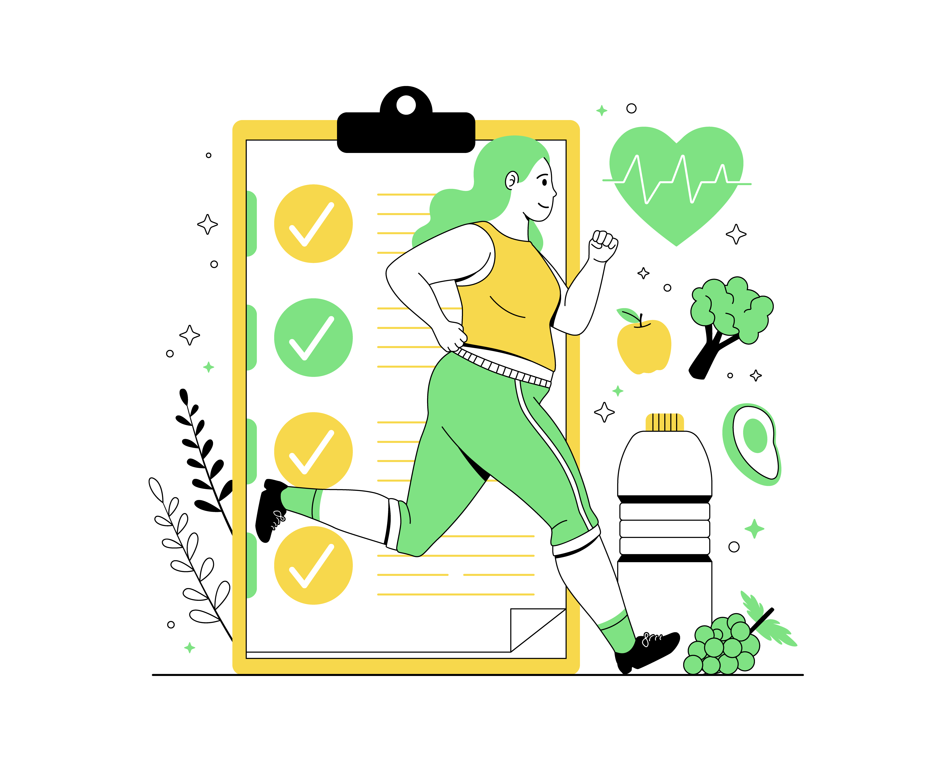
What is a Healthy Weight?
A person’s ideal body weight varies by gender, age, height and frame. Your body mass index and waist circumference provide good indicators of whether you’re at a healthy weight.
The recommended range of BMI is 18.6-24.9 and a waistline measurement of no more than 35 inches for women and 40 inches for men.
A BMI of less than 18.5 is underweight.
Notes:
SOURCES
https://www.goredforwomen.org/en/know-your-risk/know-your-numbers/key-numbers-to-know-for-your-heart-health-infographic
https://www.heart.org/en/healthy-living/healthy-eating/losing-weight/bmi-in-adults

Slide 5
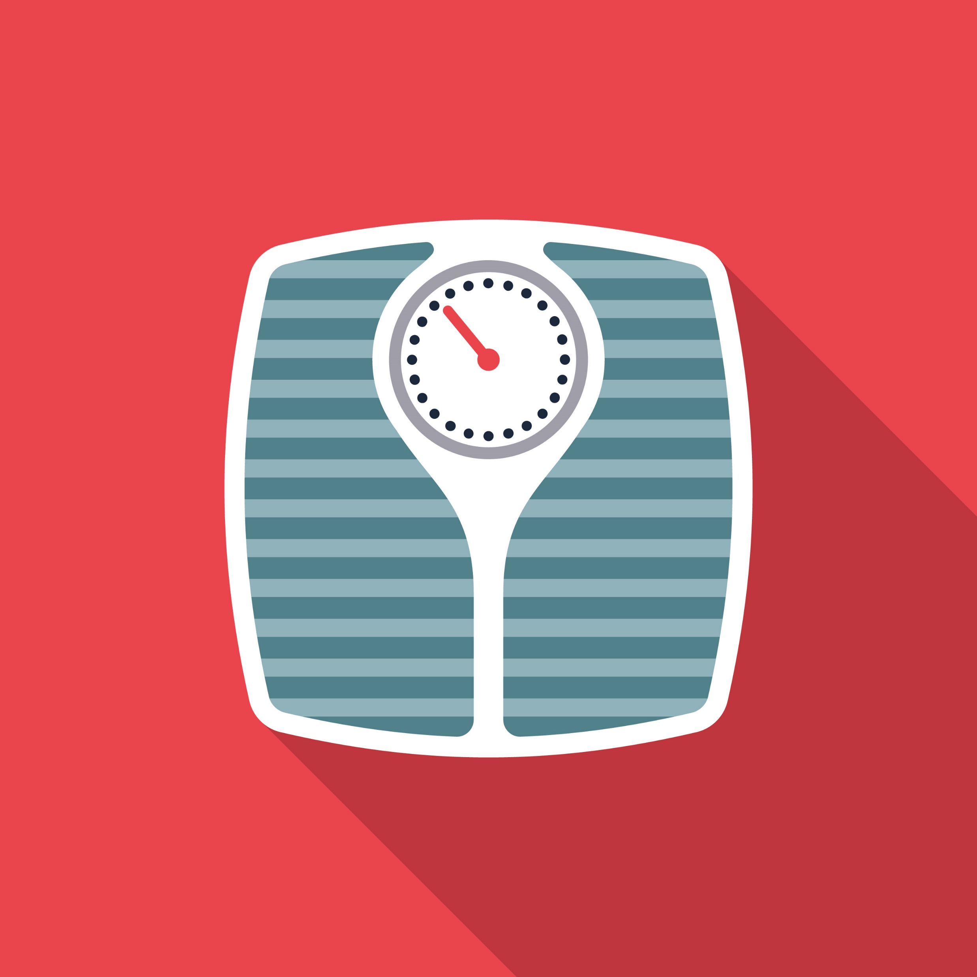
Understanding Your BMI
BMI is a numerical value of your weight in relation to your height.
Your doctor or health care professional can help you figure out if your weight is healthy for your age and body.
You can also use an online BMI calculator from the CDC or NIH to determine your number. Consult a health care professional about your numbers.
Notes:
SOURCES
https://www.heart.org/en/healthy-living/healthy-eating/losing-weight/bmi-in-adults
https://www.heart.org/en/healthy-living/healthy-eating/losing-weight/extreme-obesity-and-what-you-can-do

Slide 6

What About BMI in Children?
Calculating BMI in children and teens ages 2 to 19 takes sex and age in account. The CDC has an online BMI calculator for children.
BMI for children is measured in a percentile because they are still growing. A healthy weight is the 5th percentile to less than the 85th percentile for children.
Always consult your child’s pediatrician about their weight and BMI.
Notes:
SOURCES
https://www.cdc.gov/bmi/child-teen-calculator/bmi-categories.html
https://www.cdc.gov/bmi/child-teen-calculator/index.html

Slide 7


How to Talk to Kids About Weight
Sometimes, our bodies can store more fat than they need. That happens when we eat too much unhealthy food or don’t move our bodies enough. When our bodies have too much weight, it can make us feel unhealthy and hurt our hearts.
It’s really important to be active and make healthy choices when we are eating. When you are full, stop eating. Sometimes we might eat if we’re bored, but we should only eat if we are hungry.
Just like we need to take care of our toys or pets, we also need to take care of our bodies. Everyone’s body is different and we have different needs. Having a healthy weight is not about being a special size or shape, but about taking care of our bodies and feeling good inside and out.
Notes:
SOURCES
https://www.heart.org/-/media/Healthy-Living-Files/LE8-Fact-Sheets/For-Kids/lifes_essential_8__for_kids_balanaced_bodies.pdf?sc_lang=en

Slide 8
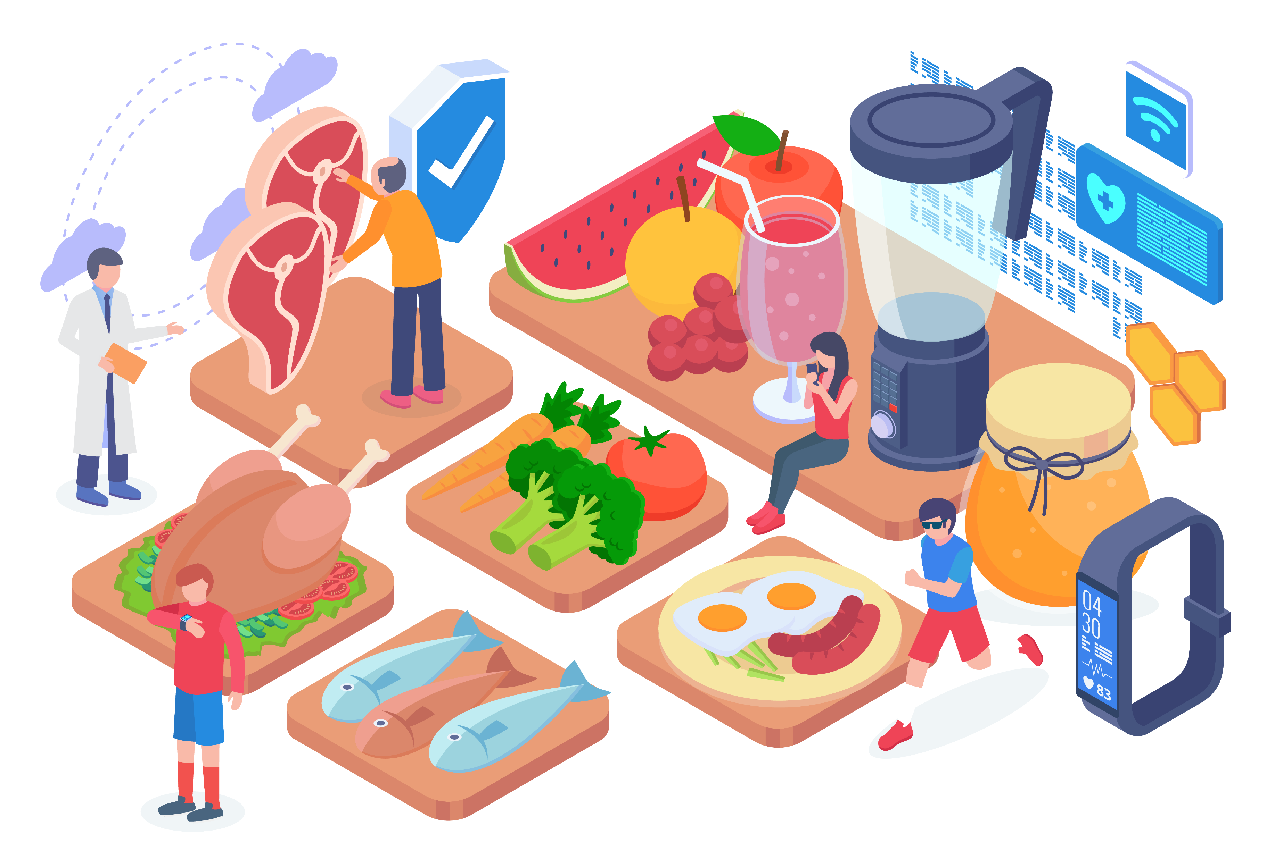
Balanced Eating
Enjoy vegetables, fruits, whole grains, beans, legumes, nuts, plant-based proteins (like beans, lentils, nuts), lean animal proteins (like skinless poultry, fish, seafood, low-fat dairy).
Drink plenty of water throughout the day.
Use plant-based oils, such as olive, canola, or avocado oil.
Notes:
SOURCE
https://www.heart.org/en/healthy-living/healthy-lifestyle/lifes-essential-8/how-to-eat-better-fact-sheet

Slide 9
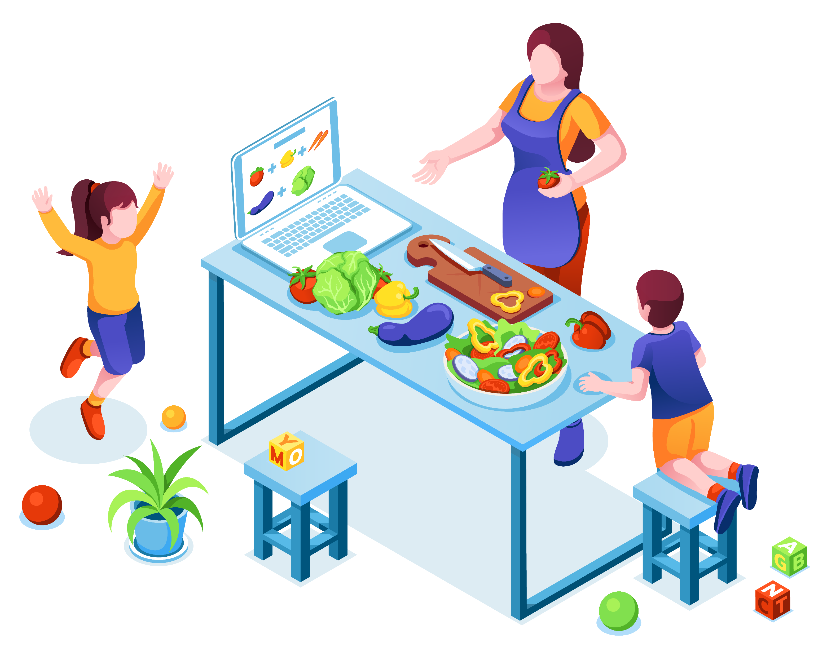
Balanced Eating as a Family
Make meals together. Include kids in the process of both grocery shopping and food prep.
Assign kid-friendly duties such as filling lunch bags or cleaning produce.
Involving everyone in meal planning, grocery shopping and cooking will mean less work and more time for family fun.
Notes:
SOURCES
https://www.goredforwomen.org/en/mom-life/just-for-mom/healthy-habits-tips-for-busy-families

Slide 10
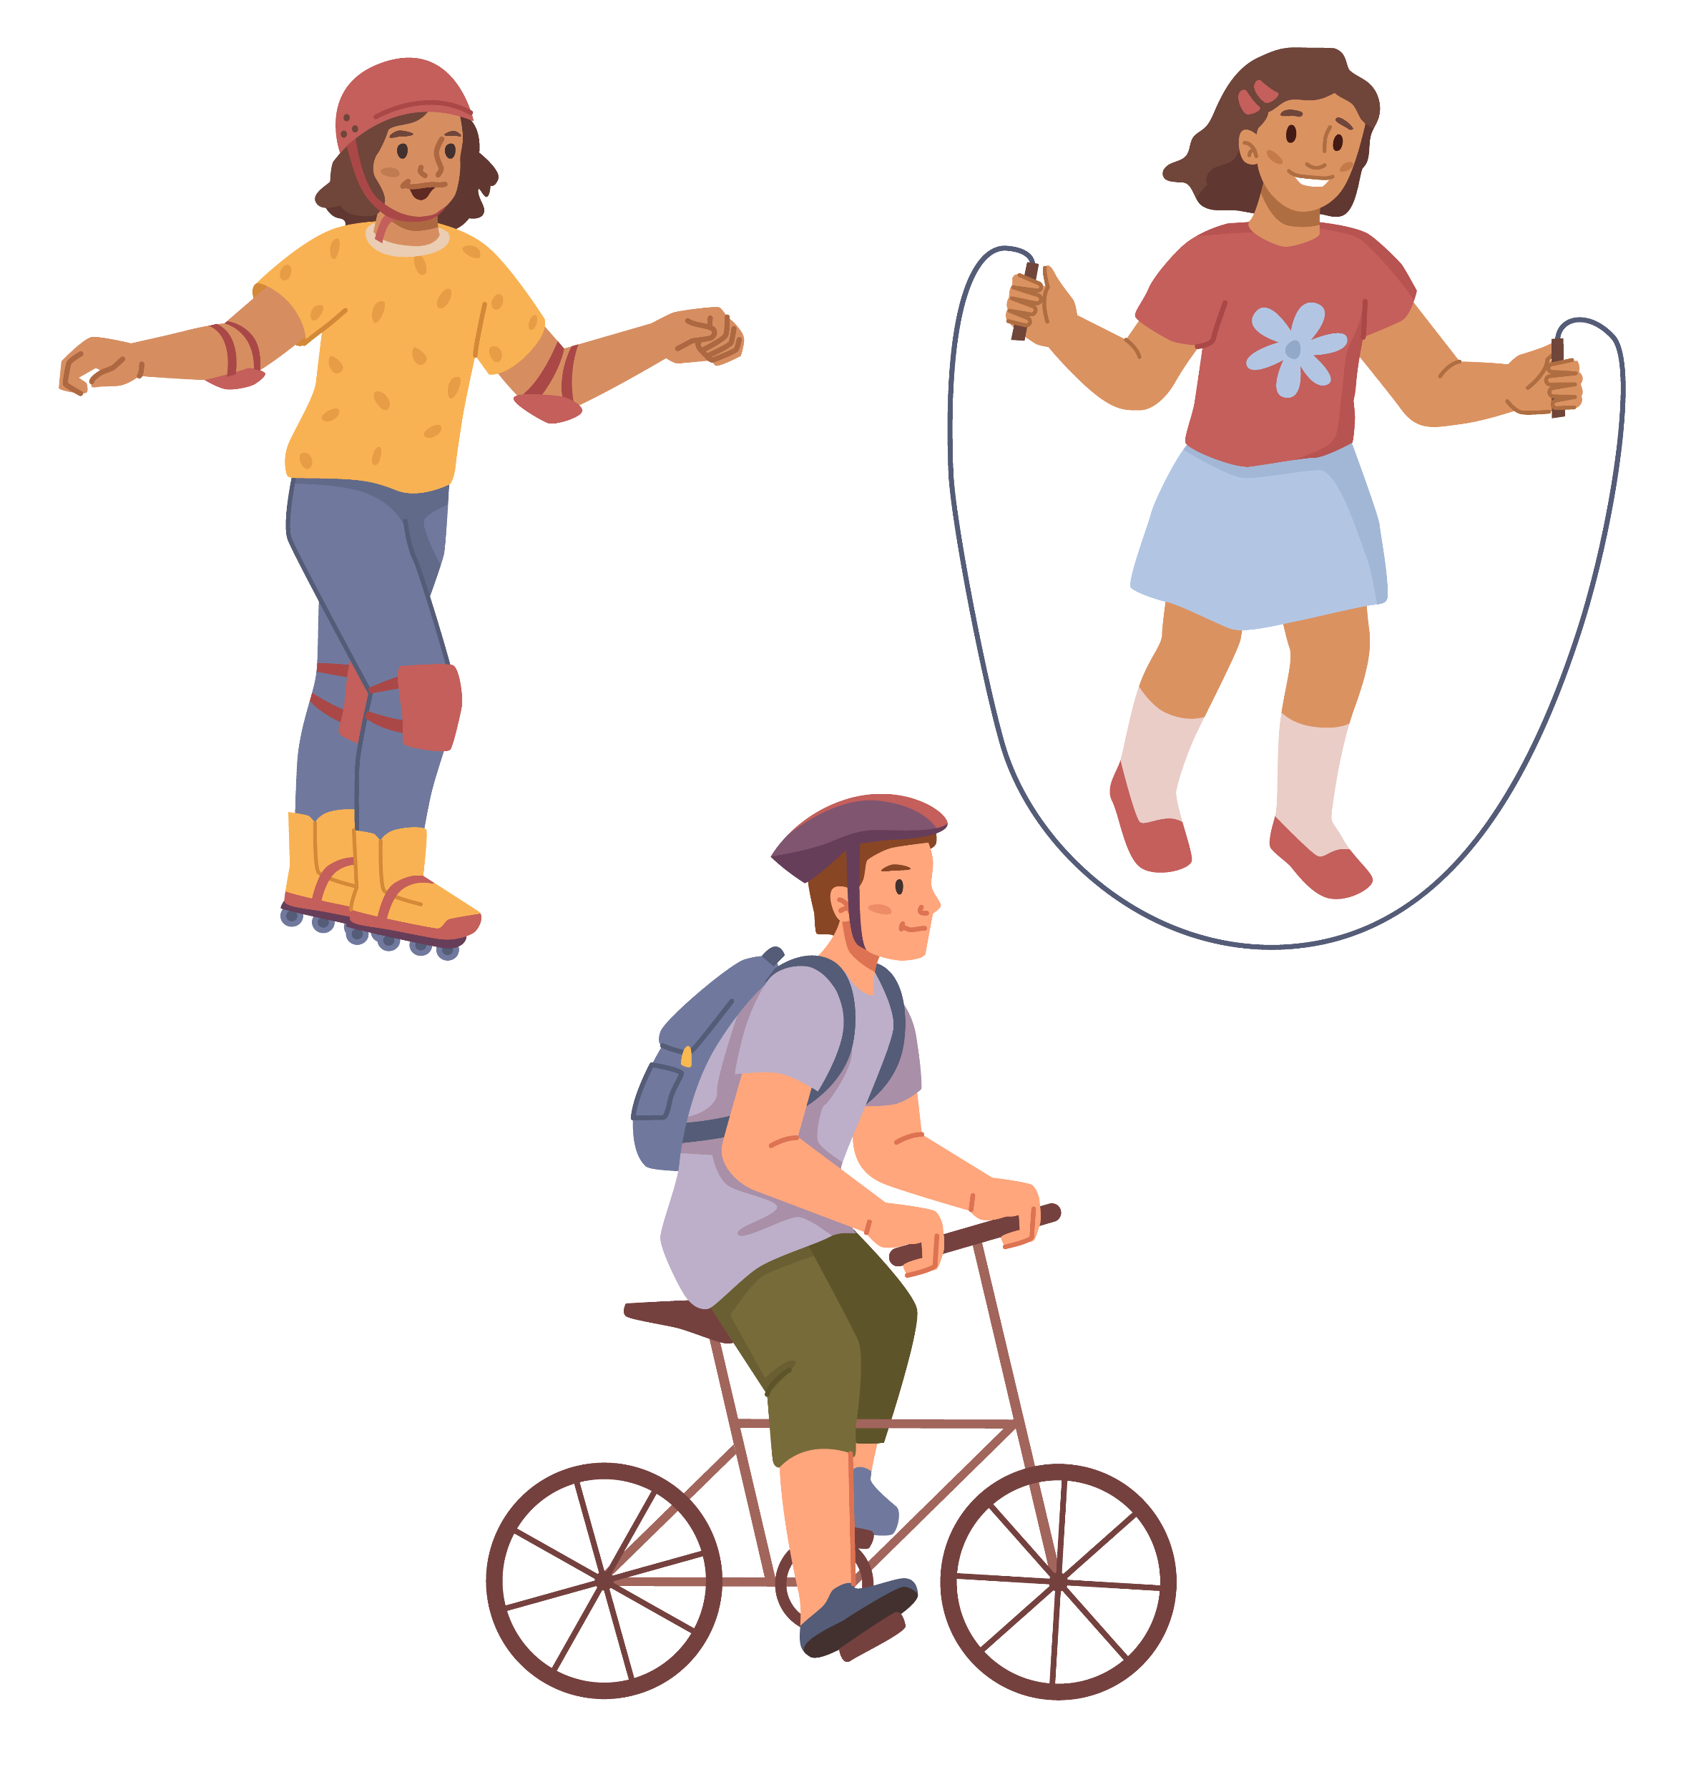
Getting Active as a Family
Take a walk. Make it fun by making it a nature walk or a scavenger hunt!
Play your favorite games like tag or musical chairs.
Create an obstacle course in the backyard.
Explore new parks or rec centers together.
Team up with other parents, friends, or neighbors and play games like kickball or volleyball.
Turn on the music and have a dance party!
Notes:
SOURCE
https://www.goredforwomen.org/en/mom-life/for-moms-with-elementary-age-kids/moving-with-your-kids-can-be-fun-and-healthy

Slide 11
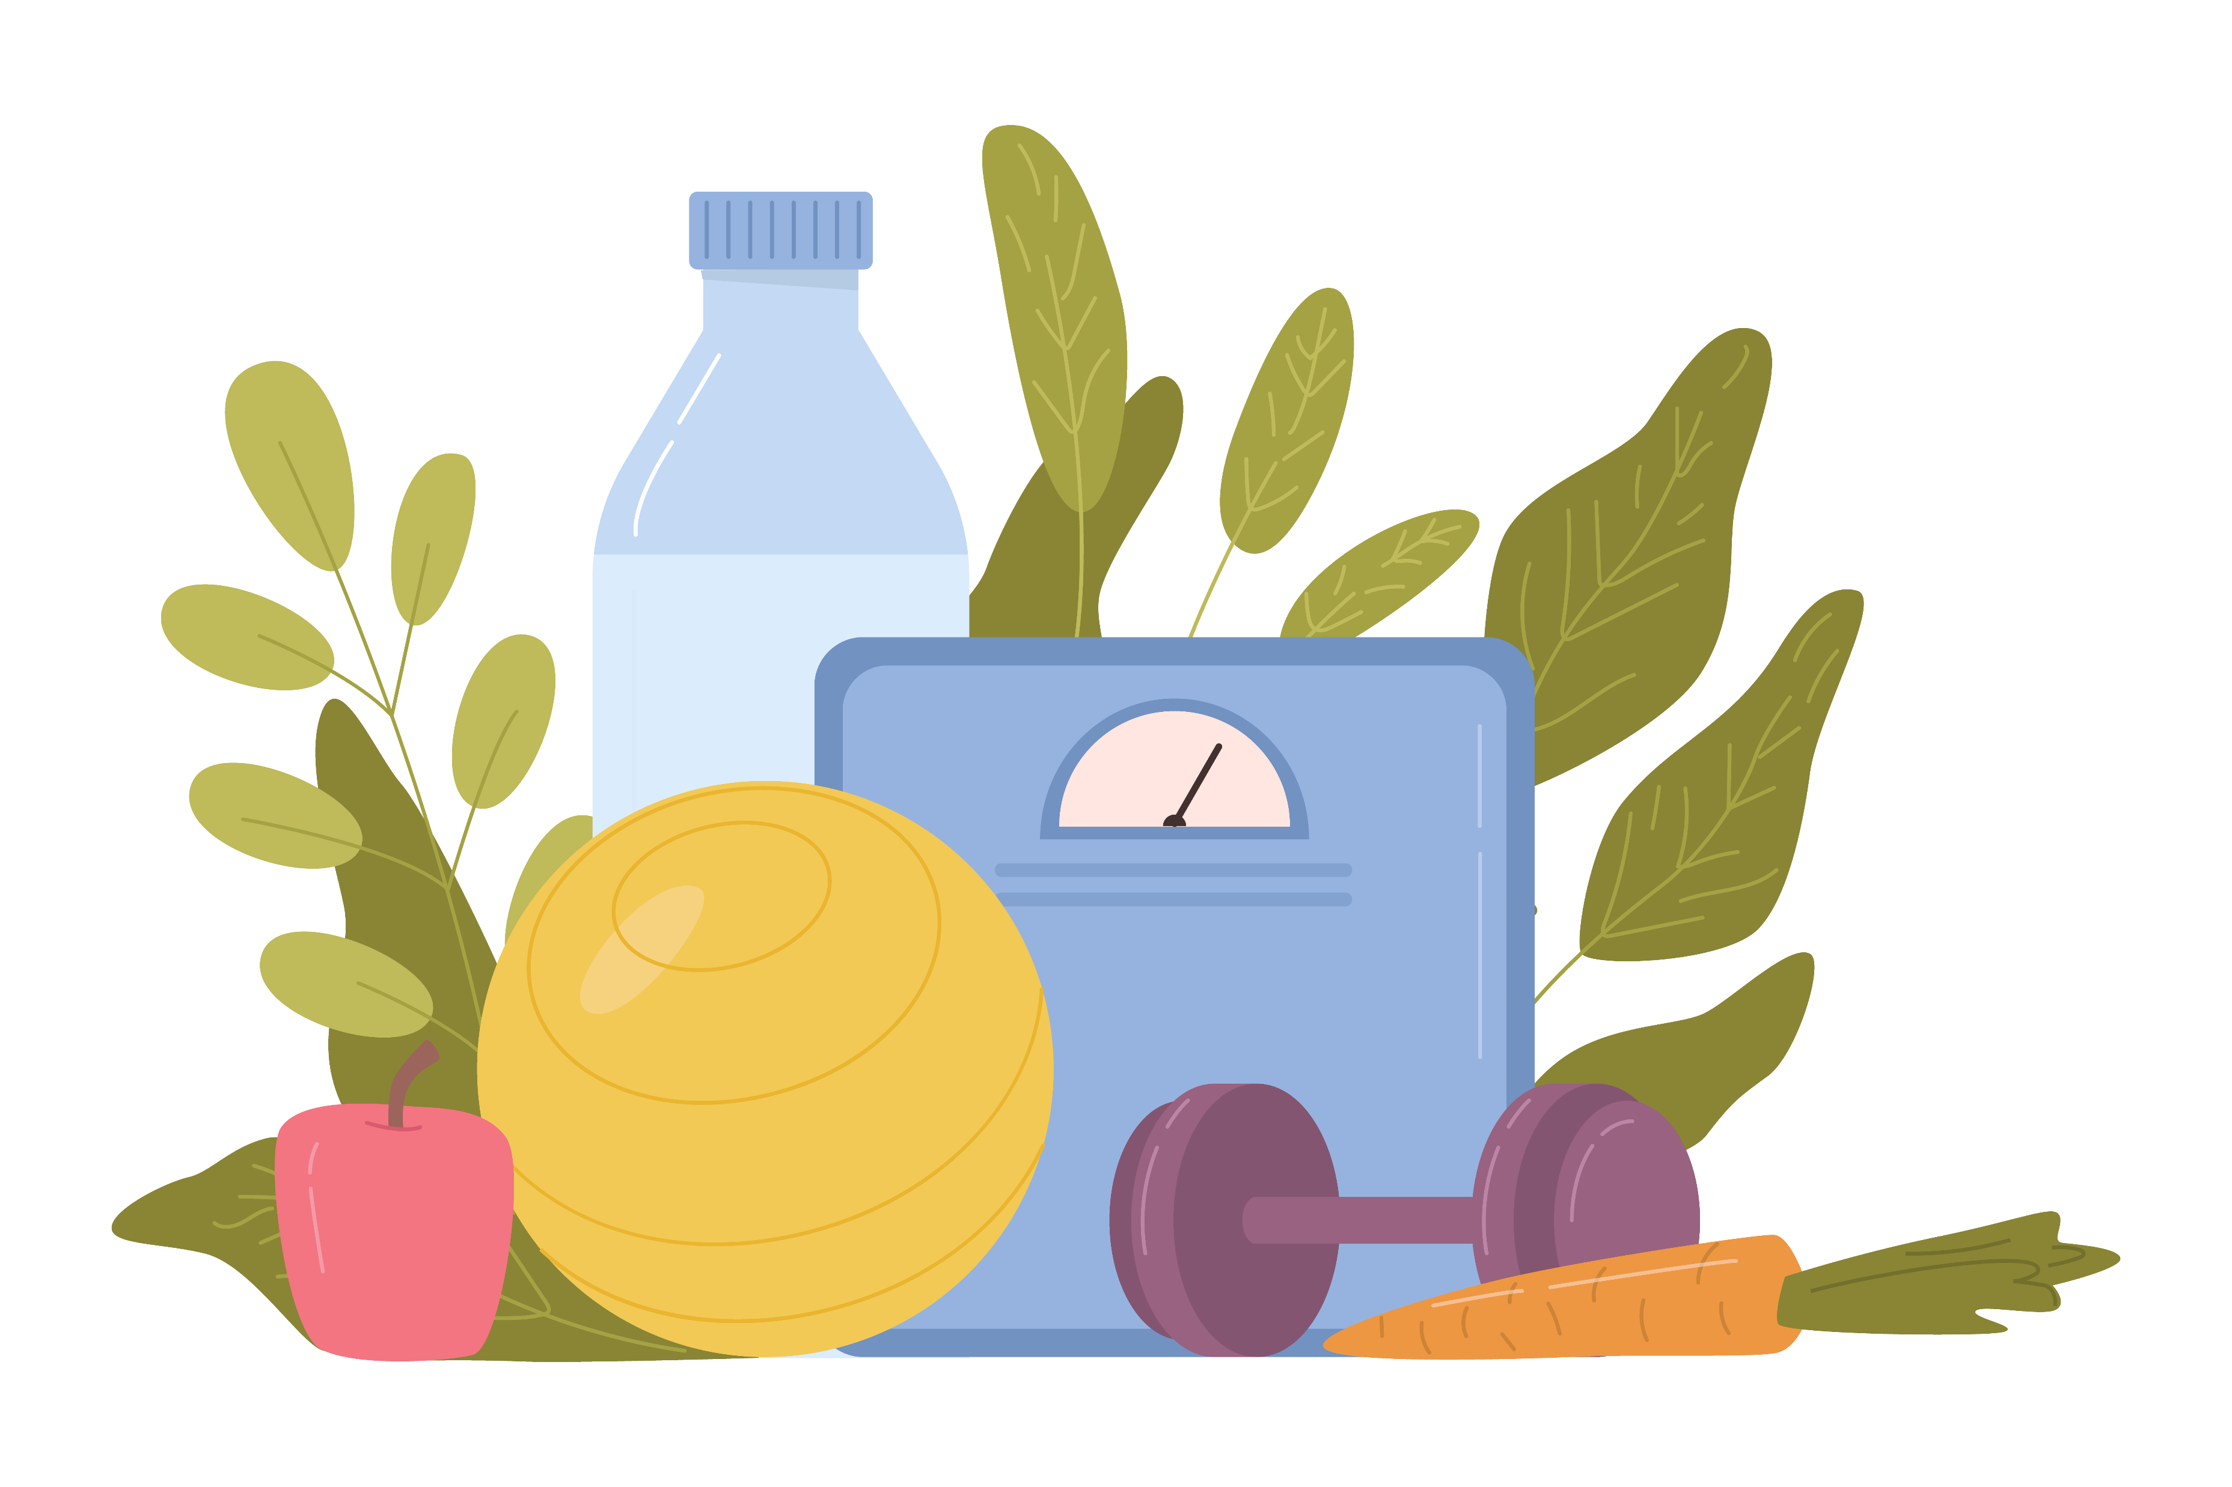
Other Tips for Weight Management Success
Increase the amount of fiber you eat and water you drink.
Add protein to your breakfast, which will help you feel full for longer.
Read nutritional labels for nutrition and calorie content. Learn about portion sizes. Pay attention to the number of serving sizes in each package.
Stress can trick your body into feeling hungry or craving unhealthy foods. Exercise can reduce stress.
Seek help. Talk with your doctor or registered dietitian for help with managing your weight.
Notes:
SOURCE
https://www.heart.org/en/healthy-living/healthy-lifestyle/lifes-essential-8/how-to-manage-weight-fact-sheet

Slide 12
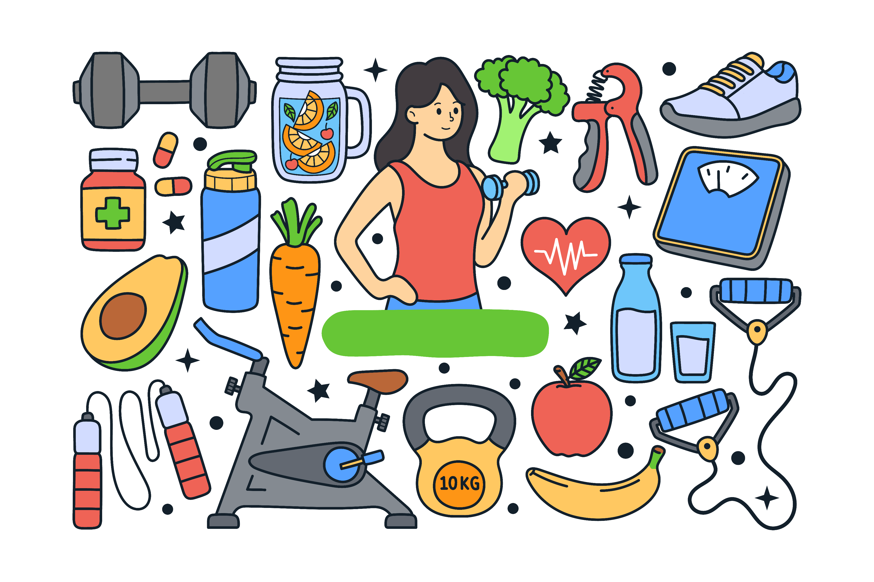
Wrap Up
A healthy weight means less risk of heart disease, stroke or other health problems – and a better quality of life!
Calculate your BMI and your child’s BMI, but always consult a health care professional about weight management.
Balanced eating and getting active can help maintain a healthy weight.
Remind children that having a healthy weight is not about being a special size or shape, but about taking care of our bodies and feeling good inside and out!

